Slide 1
FURNISMART SOLUTIONS SALES DATA
By: Saheed Tijani

Slide 2
TABLE OF CONTENT
1. INTRODUCTION
2. THE BUSINESS QUESTIONS
3. KEY PERFORMANCE INDICATORS
4. RECOMMENDATIONS
5. CONCLUSION

Slide 3

INTRODUCTION
FurniSmart Solutions is a visionary and innovative fictional company specializing in the field of office equipment supplies and contemporary office furniture.

Slide 4
In my role as a Data Analyst, my responsibility extended to creating detailed reports that shed light on FurniSmart Solutions' current operations and serve as vital resources for crafting effective strategies.
It's worth noting that the data used in these reports is entirely fictitious, providing a simulated insights that FurniSmart Solutions could gain from this analysis.
Saheed

Slide 5
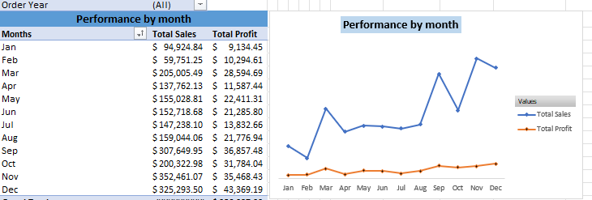
THE BUSINESS QUESTIONS
In which month of the year did the company generated the highest profit?
The table below presents a monthly summary of sales and profit data.
Saheed

Slide 6
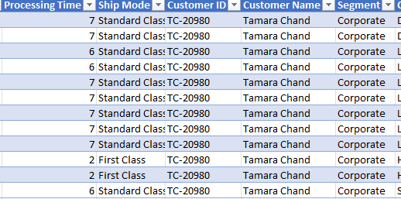
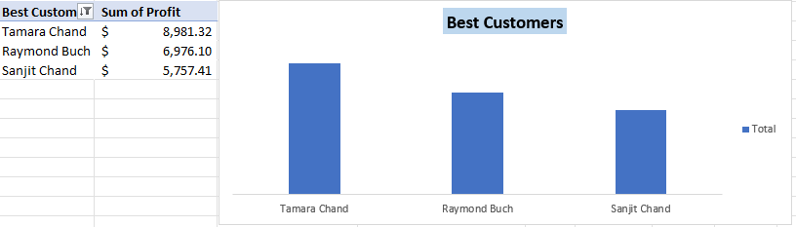
Who is the most valuable customer?
Tamara Chand, our most lucrative customer, contributed a substantial profit of $8,981.32 to our business. Her loyalty was evident, having made 12 repeated purchases.

Slide 7

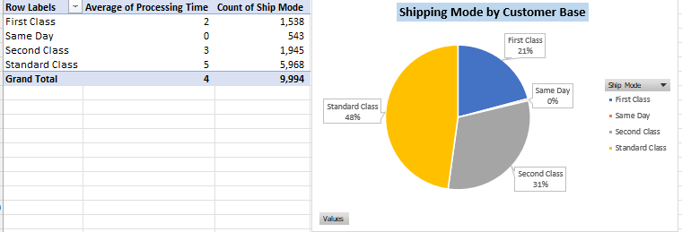
What is the effect of shipping processing time and shipping mode on customer retention?
The analysis highlights a concerning trend where a significant number of standard shipping orders experienced delays.
Such discrepancies in delivery times could potentially lead to customer dissatisfaction. It's advisable for FurniSmart Solutions to proactively address this issue as it may impact customer retention.

Slide 8
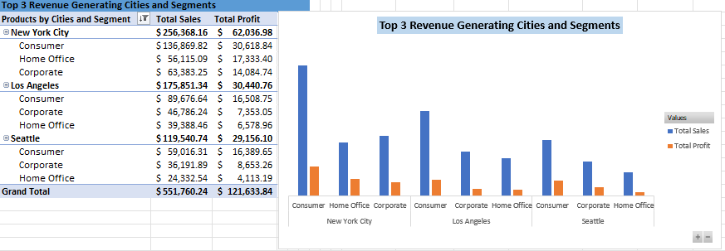
Which Segment and City have the highest and lowest revenue?
The top three cities leading in revenue generation are identified as New York, Los Angeles, and Seattle, with the Consumer segment notably contributing the most revenue.
I strongly recommend that these top three cities consider increasing their supply to meet the high demand in these areas. By doing so, they can optimize their profit potential and enhance their market presence.

Slide 9
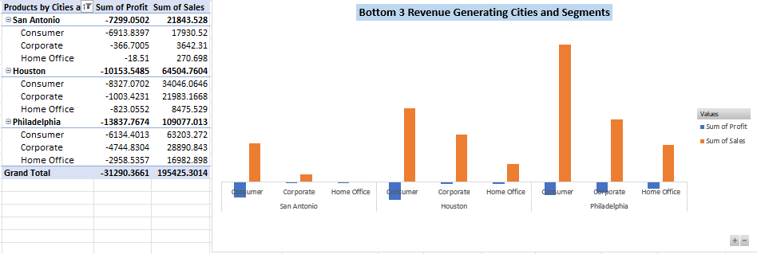
On the other end of the spectrum, the least revenue-generating cities include San Antonio, Houston and Philadelphia. Based on the analysis, I propose the strategic closure of sales outlets in cities where the sales revenue falls below the $100 mark.
This recommendation stems from the observation that the majority of these outlets are operating at a loss, and the profits generated are insufficient to cover the associated overhead costs. By implementing this course of action, the business can redirect resources to more profitable regions and strengthen its overall financial health.

Slide 10
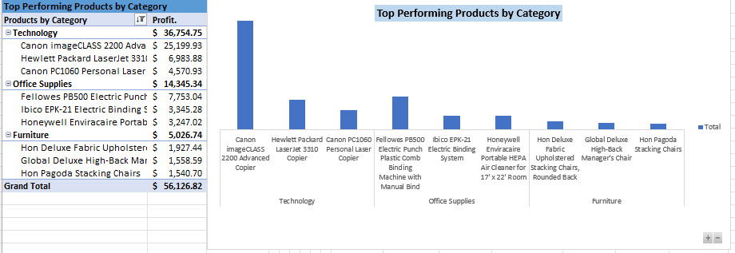
What are the best performing products by category?
A concerning revelation is that out of the 9,994 products within the category, a substantial 304 products are operating at a loss. To optimize profitability, it is recommended to discontinue these underperforming products. By doing so, the FurniSmart Solutions can focus its resources, efforts, and budgets on strengthening the best-performing products.

Slide 11
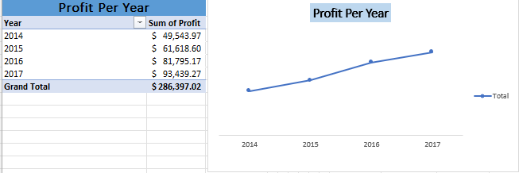
Over the last 4 years, how much profit have FurniSmart achieved?
FurniSmart's financial performance has displayed a notable upward trend over the past four years, spanning from 2014 to 2017. In 2014, FurniSmart Solutions recorded a profit of $49,543.97, which increased to $61,618.60 in 2015, further climbing to $81,795.17 in 2016, and ultimately peaking at $93,439.27 in 2017.
This positive trend in profit growth reflects the company's effective strategies, improved market positioning, or operational efficiency.

Slide 12
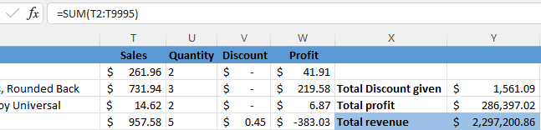
KEY PERFORMANCE INDICATORS
Total Revenue
The Total Revenue, which stands at $2,297,200.86, serves as a pivotal Key Performance Indicator (KPI) in evaluating overall FurniSmart's financial health

Slide 13
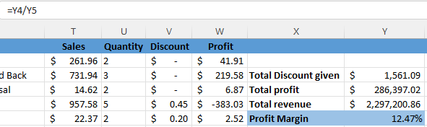
Profit Margin
The Profit Margin of 12.47% signifies that for every dollar of revenue, the company retains about 12.47 cents as profit after covering expenses. With a Total Revenue of $2,297,200.86 and a Total Profit of $286,397.02, it's evident that the company is running profitably.
To enhance profitability, focus on cost control and revenue growth strategies, potentially through expanding into higher-margin product lines or increasing sales in regions or segments with higher profitability.

Slide 14
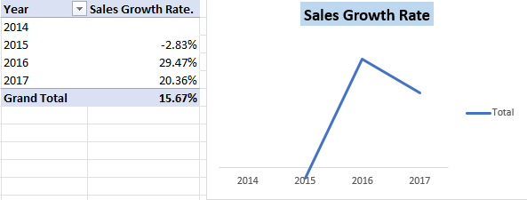
Sales Growth Rate
Over the years, the company's sales have experienced fluctuations. In 2015, there was a decline of 2.83%, followed by substantial growth in 2016 and 2017, with growth rates of 29.47% and 20.36% respectively. To sustain and improve performance, it's crucial to identify the factors contributing to the fluctuations.
A drop in 2015 suggests a potential issue that needs attention, while the subsequent growth indicates resilience and adaptability.

Slide 15
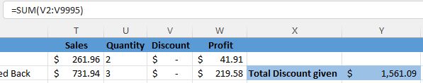
Total Discount Given
The total discount given by FurniSmart Solution, amounting to $1,561.09, is a crucial metric to consider in conjunction with the Total Revenue of $2,297,200.86 and Total Profit of $286,397.02. While discounts can attract customers, it's vital to ensure they don't overly impact profitability. To optimize profitability, it's recommended to monitor and manage discounts closely.

Slide 16
RECOMMENDATIONS
Operational Efficiency: FurniSmart Solutions need to streamline internal processes by reducing operational costs through process optimization.
Product Performance: Regularly assess and upgrade products based on customer feedback and market trends.
Customer Retention Strategy: Develop customer retention programs to reduce churn by addressing pain points and improving customer satisfaction.
Market Expansion: Explore new markets or customer segments to diversify revenue streams and mitigate risks

Slide 17
CONCLUSION
In conclusion, addressing the key business questions through data analysis has provided valuable insights for decision-making. The analysis revealed that peak sales months, such as November and December, coincide with higher profits, emphasizing the strong correlation between sales and profitability.
It is evident that supply adjustments should be considered in the top-performing cities to meet growing demand, while cities with consistently low revenue require strategic restructuring, including the closure of outlets unable to cover overhead costs.
This data-driven approach will enable FurniSmart Solution to optimize resources, enhance profitability, and strategically position themselves for sustained growth in an ever-evolving marketplace.

